Slide 1

1
1

Slide 2

LOGICAL GATE
LOGICAL GATE ARE ELECTRONIC COMPONENTS THE OUTPUT OF GATE BASED ON ONE OR MORE INPUTS
TWO VOLTAGE LEVELS CAN BE REPRESENTED AS THE TWO DIGITS 0 AND 1

Slide 3

ORDERED LOGIC GATES (SIMPLE EXPLANATION)
AND GATE → OUTPUTS 1 ONLY IF BOTH INPUTS ARE 1.
NAND GATE → OPPOSITE OF AND, OUTPUTS 0 ONLY IF BOTH INPUTS ARE 1.
OR GATE → OUTPUTS 1 IF AT LEAST ONE INPUT IS 1.
NOR GATE → OPPOSITE OF OR, OUTPUTS 1 ONLY IF BOTH INPUTS ARE 0.
XOR GATE → OUTPUTS 1 IF INPUTS ARE DIFFERENT.
XNOR GATE → OUTPUTS 1 IF INPUTS ARE THE SAME.
BUFFER → PASSES THE INPUT UNCHANGED (0 → 0, 1 → 1).

Slide 4
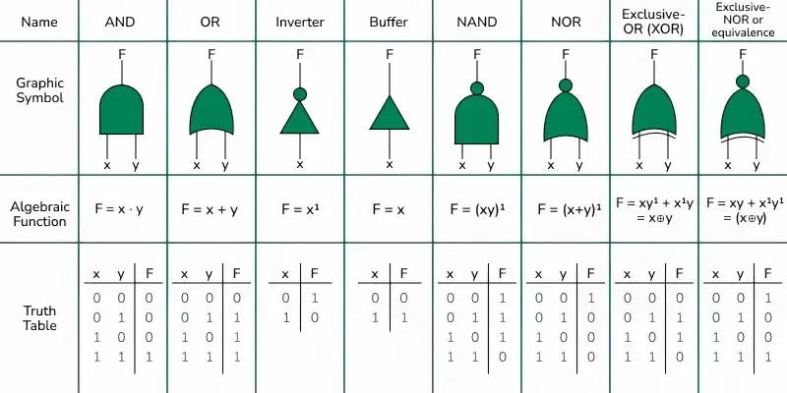

Slide 5
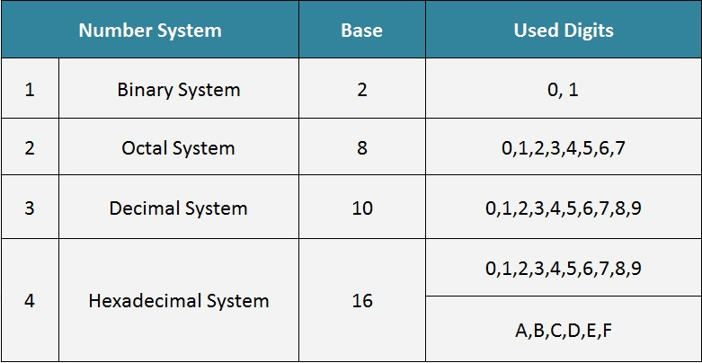


Slide 6
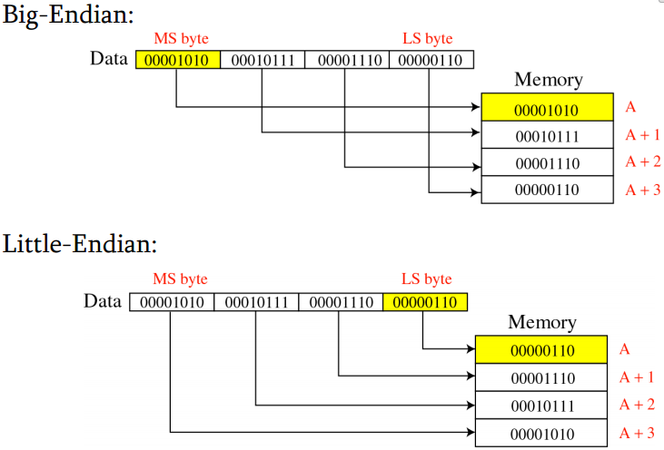

Slide 7
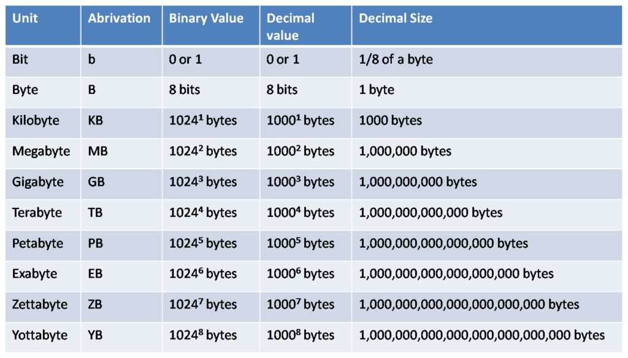


Slide 8
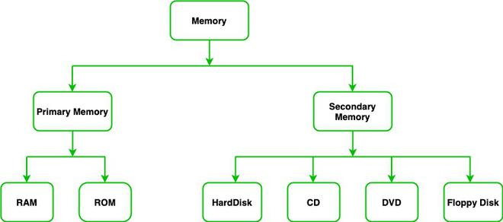
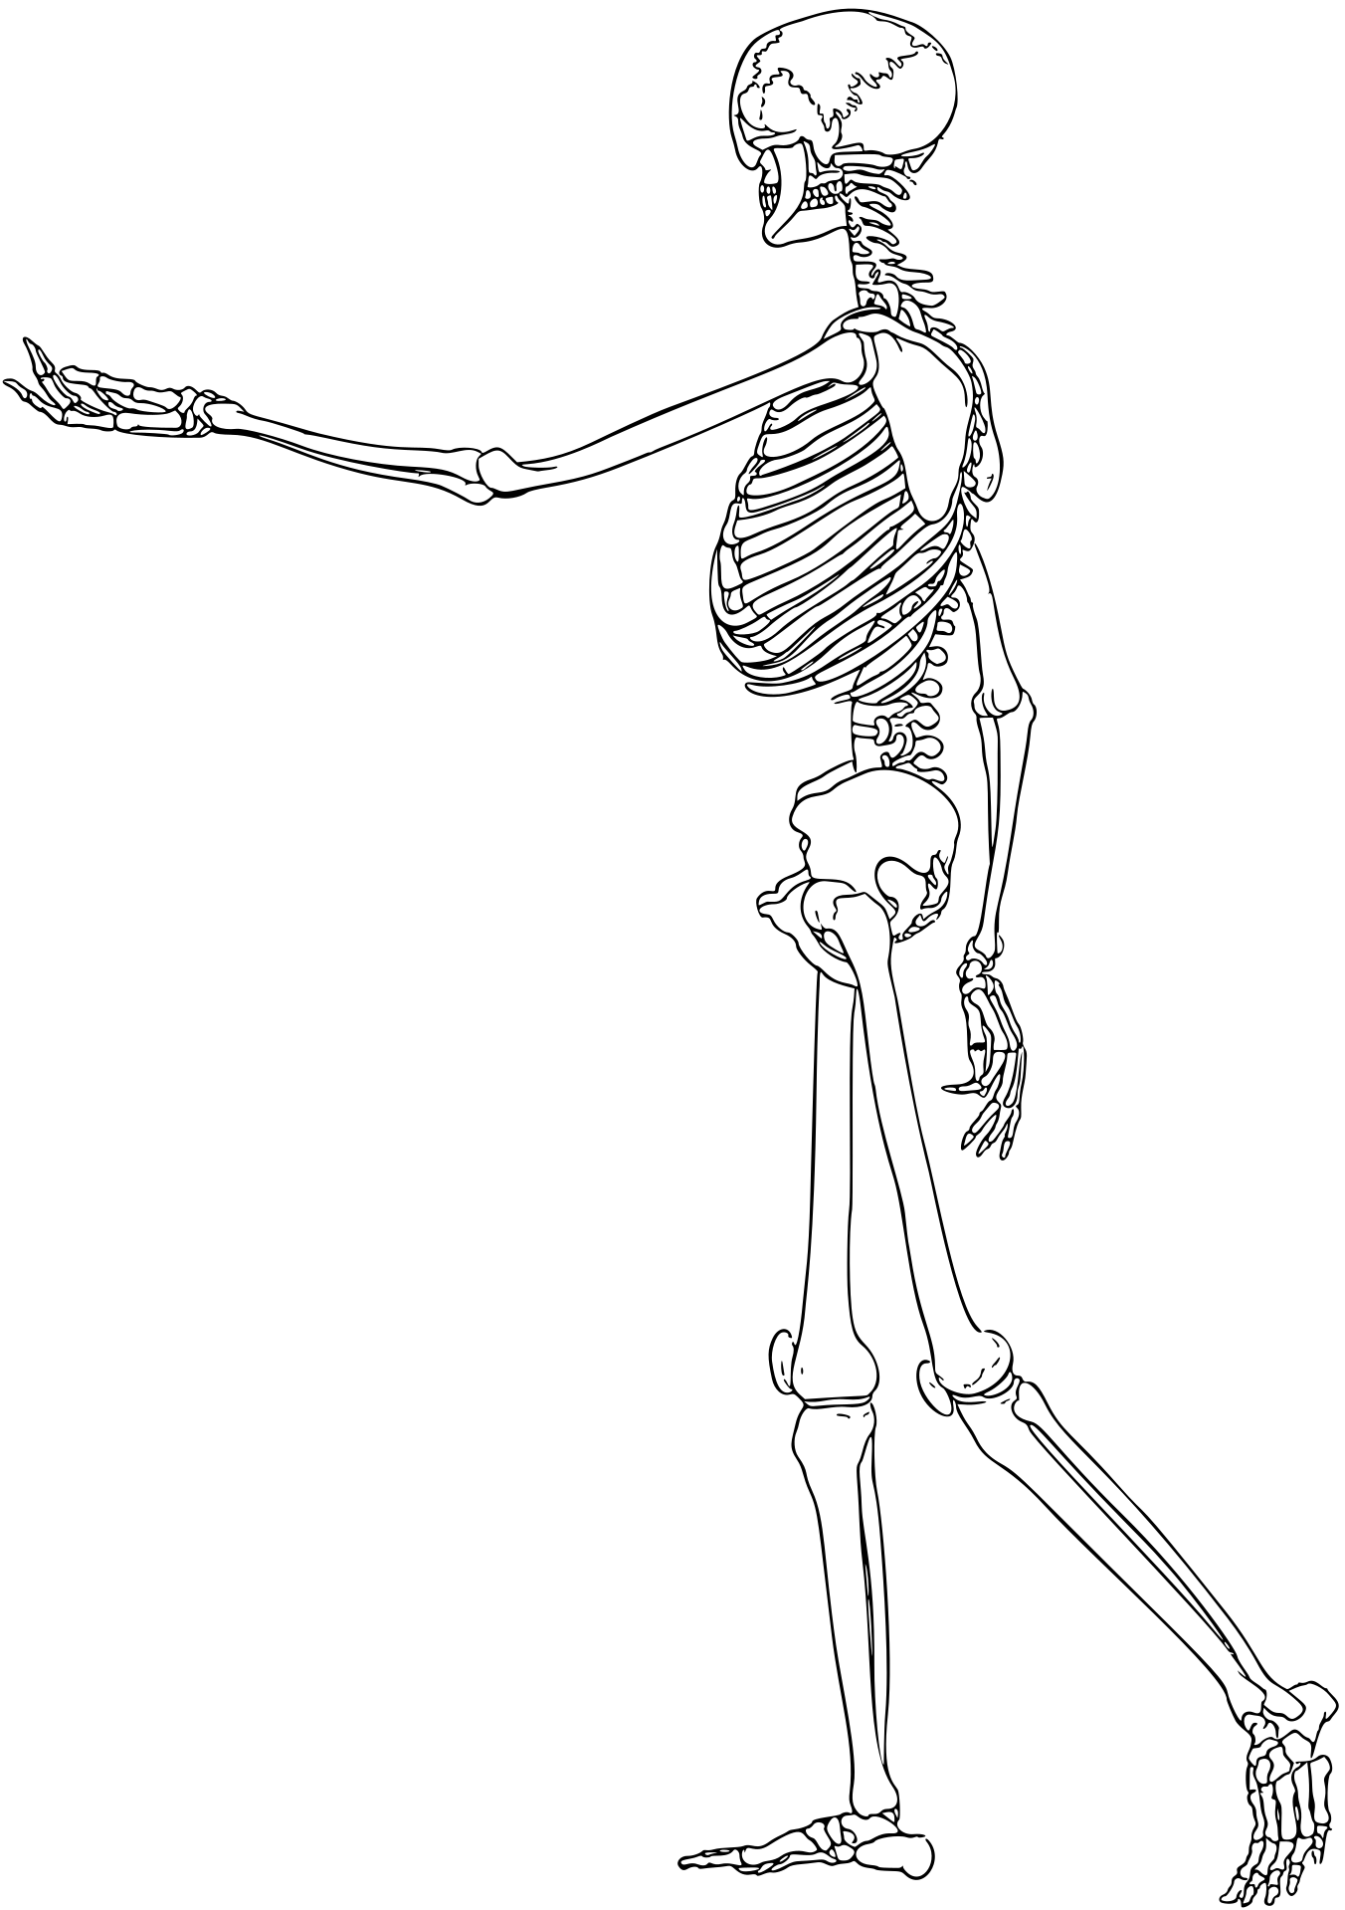

Slide 9
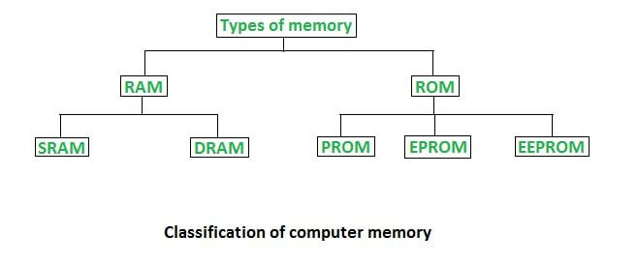

Slide 10
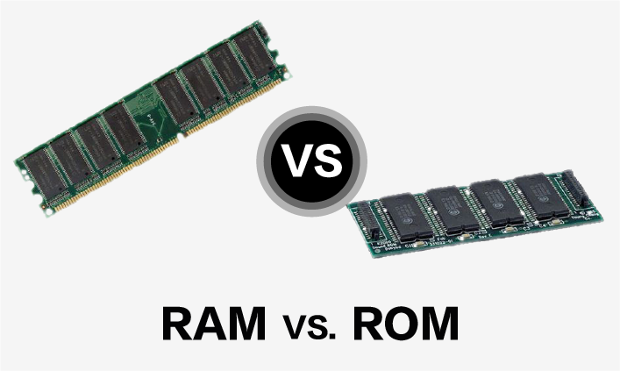

Slide 11
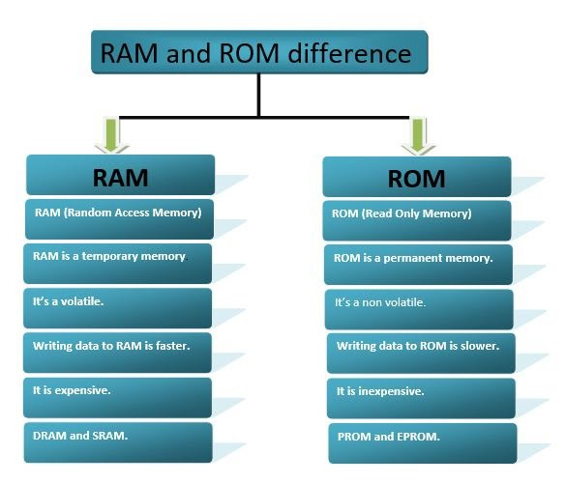

Slide 12
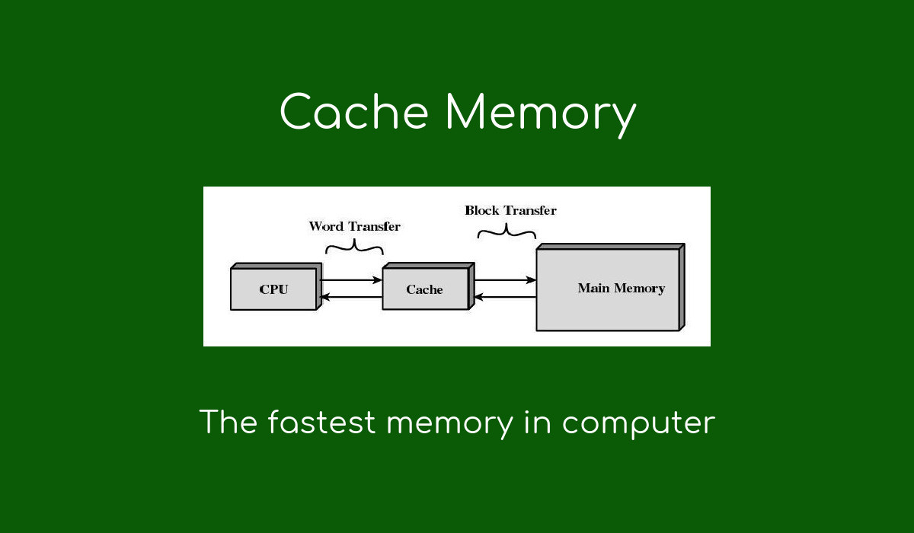


Slide 13
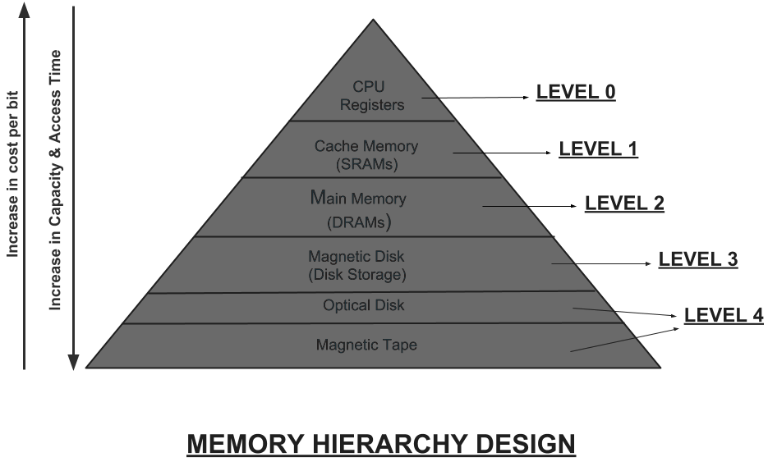


Slide 14
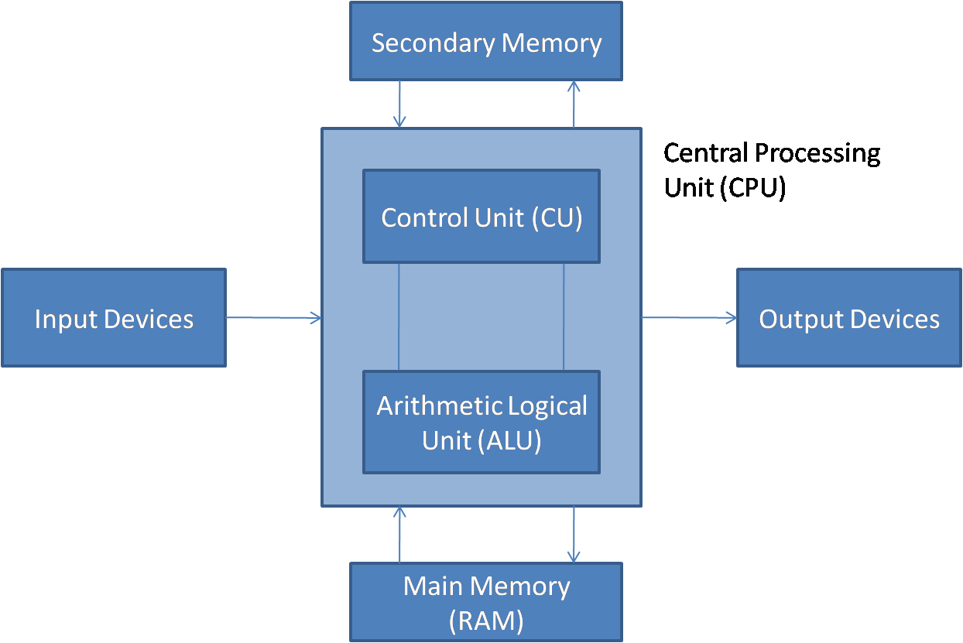


Slide 15
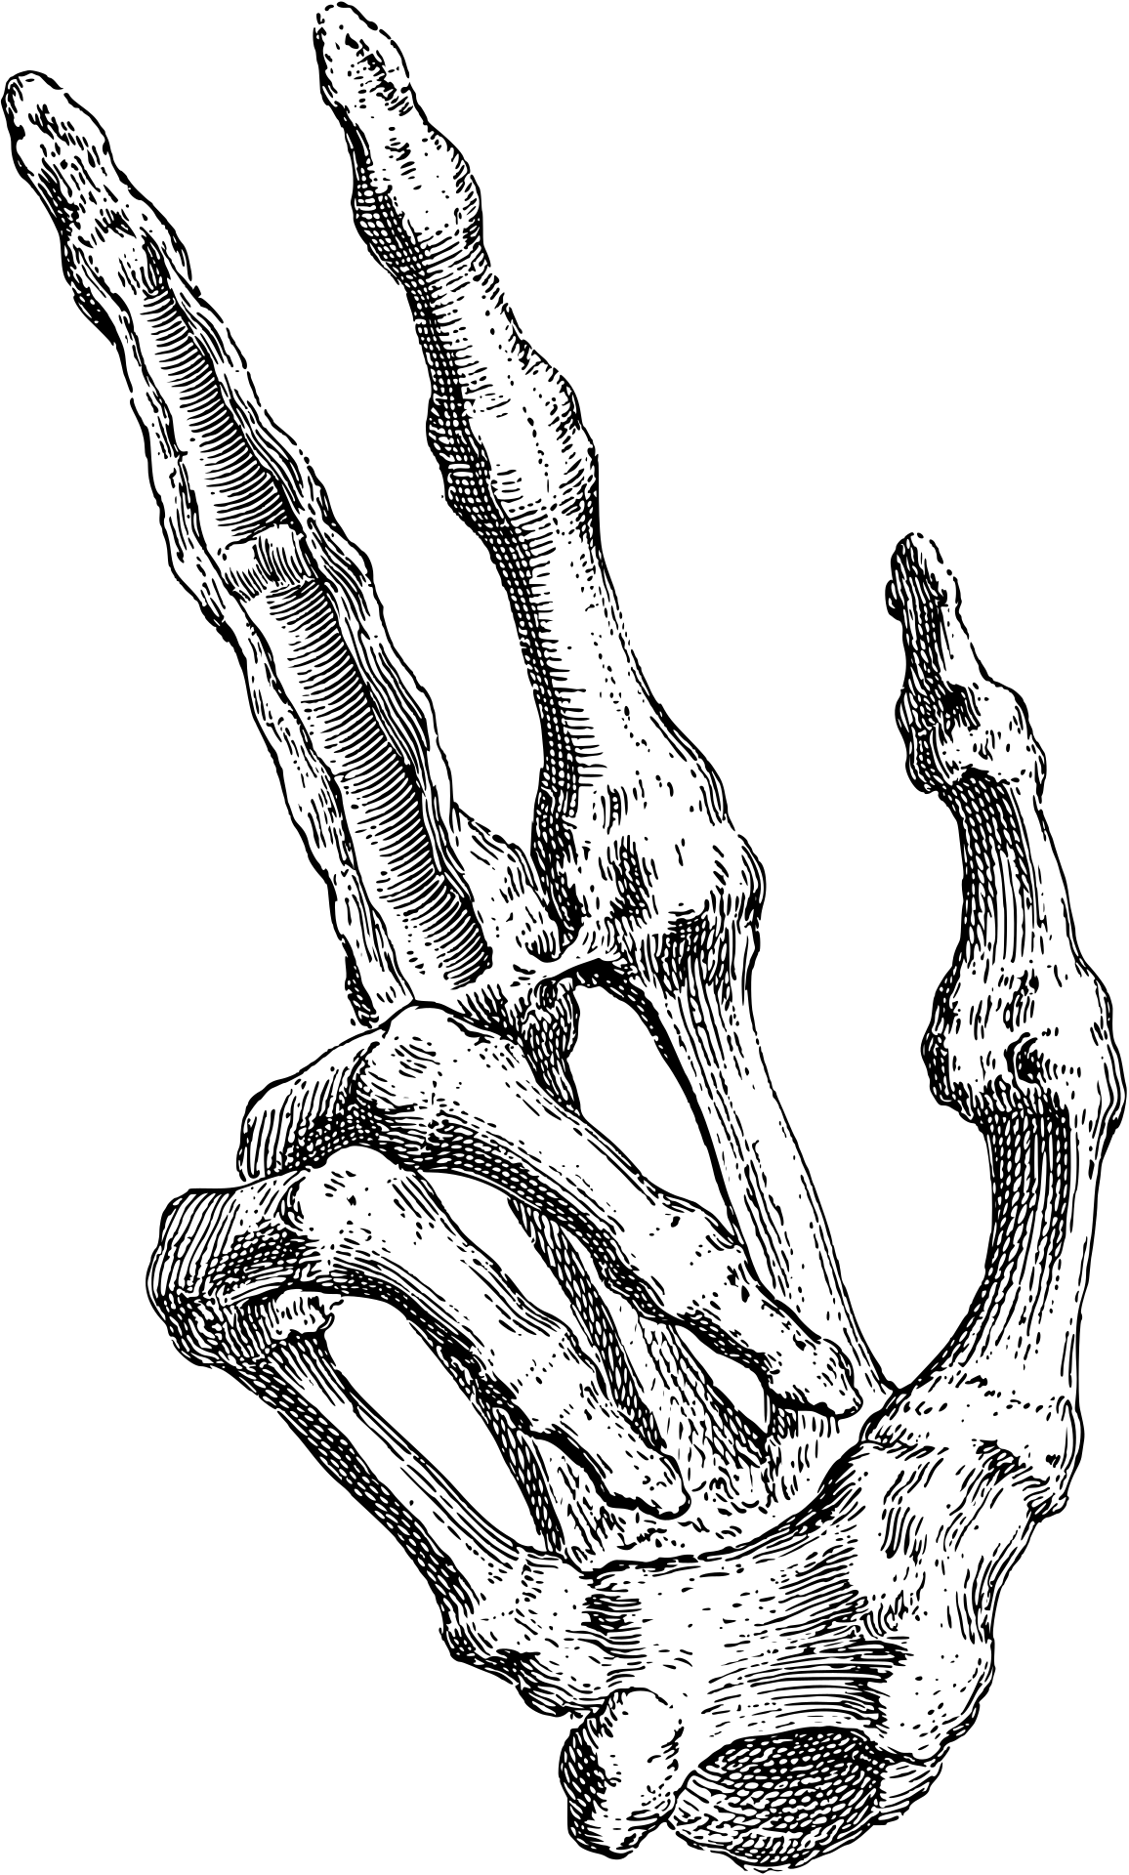
Types of Operation
Data Transfer Operations
These operations move data between memory, registers, and input/output devices.
Load (LD) – Move data from memory to a register.
Store (ST) – Move data from a register to memory.
Move (MOV) – Transfer data between registers.
Push & Pop – Stack operations for saving/restoring values.
Arithmetic Operations
These operations perform mathematical calculations.
Addition (ADD)
Subtraction (SUB)
Multiplication (MUL)
Division (DIV)
Increment (INC) & Decrement (DEC)

Slide 16

Logical Operations
These operations perform bitwise logic on binary values.
AND – Bitwise AND operation.
OR – Bitwise OR operation.
XOR – Bitwise XOR (exclusive OR).
NOT – Bitwise negation.
Shift (SHL, SHR) – Left and right shift operations.
Control Operations (Branching & Jumping)
These operations change the flow of execution in a program.
Jump (JMP) – Unconditional jump to another instruction.
Branch (BEQ, BNE, etc.) – Conditional jumps based on comparison results.
Call & Return (CALL, RET) – Used for function calls.
Looping Instructions – Iterative execution of instructions

Slide 17

Comparison Operations
These operations compare values and set flags for decision-making.
Compare (CMP) – Compares two values.
Test (TEST) – Similar to CMP but for logical conditions.
Bit Manipulation Operations
These are used for modifying specific bits in a word.
Set, Clear, Toggle Bits (SET, CLR, TGL)
Rotate (ROL, ROR)
Input/Output Operations
These operations manage data exchange with external devices.
IN – Read data from an input port.
OUT – Send data to an output port.

Slide 18
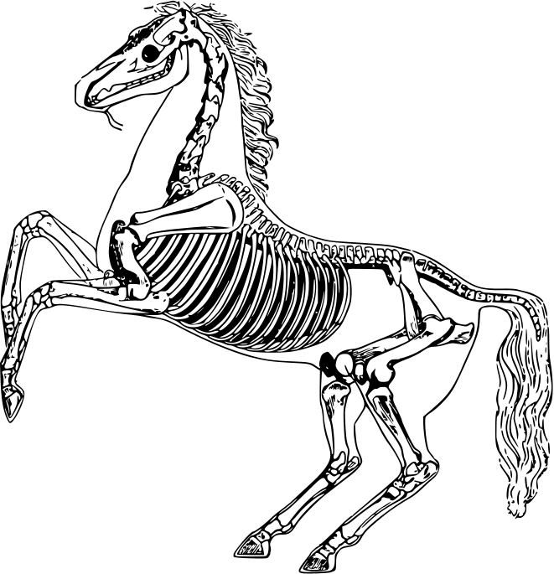
System Control Operations
These are privileged operations that control system behavior.
HALT (HLT) – Stops the CPU.
NOP (No Operation) – Does nothing but advances the instruction pointer.
Interrupt (INT) – Handles system calls or hardware interrupts.

Slide 19

Types of Bus in Computer Architecture
Data Bus – Transfers actual data between CPU, memory, and I/O devices (bi-directional).
Address Bus – Carries memory addresses from CPU to memory/I/O (uni-directional).
Control Bus – Sends control signals for coordinating operations (read, write, interrupts).
System Bus – A combination of data, address, and control buses for internal communication.
I/O Bus – Connects external devices like USB, PCIe, and SATA.
Memory Bus – High-speed link between CPU and RAM for fast memory access.
Parallel Bus – Transfers multiple bits simultaneously for short distances.

Slide 20
Intro to Registers

Slide 21
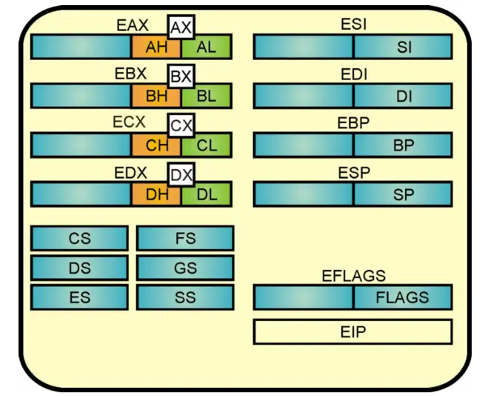
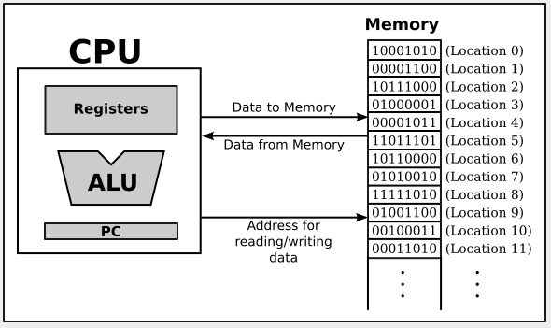

Slide 22
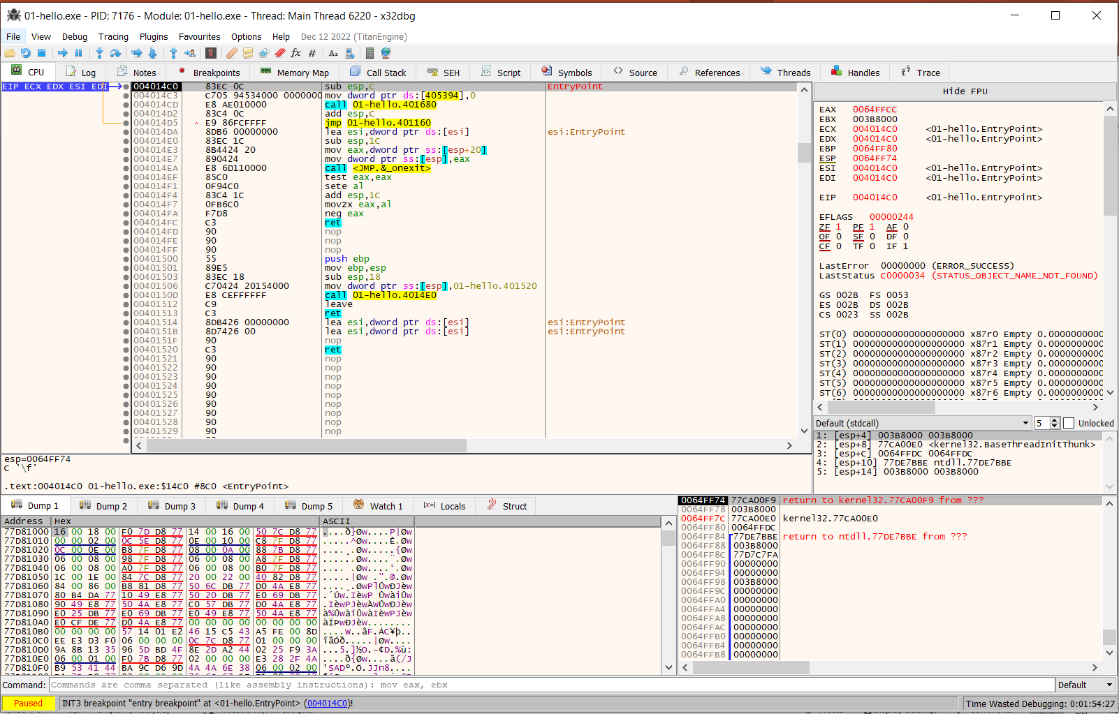

Slide 23
Basic general purpose registers
EAX
EBX
ECX
EDX

Slide 24
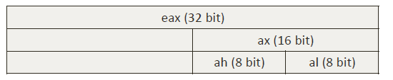
Internal structure of each register (32-bit)
EAX is dword which is 4 bytes (32 bits)
AX is a word which is 2 bytes (16 bits)
AH is a byte (8 bits)
AL is also a byte (8 bits)
If EAX = 0x12345678
AX = 5678
AH = 56
AL = 78

Slide 25
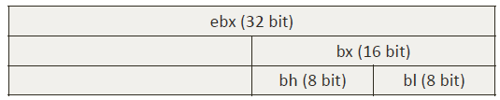
Same for EBX, ECX, EDX
For EBX,
If EBX = 0x12345678
BX = 5678
BH = 56
BL = 78

Slide 26
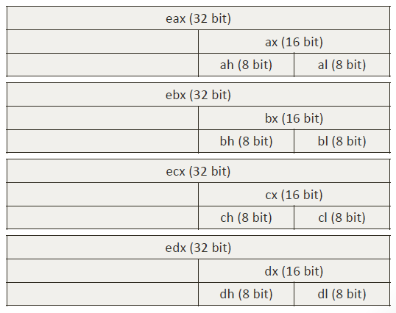

Slide 27
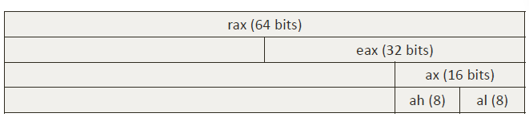
64-bit registers
RAX is qword which is 8 bytes (64 bits)
EAX is a dword which is 4 bytes (32 bits)
AX is word which is 2 bytes (16 bits)
AH is a byte (8 bits)
AL is also a byte (8 bits)

Slide 28



ESI, EDI, EIP, ESP, EBP registers
String index registers:
ESI = Source Index
EDI = Destination Index
Instruction pointer:
EIP indicates the memory current address of current instruction
Stack Frame Pointers:
ESP = address of top of stack
EBP = address of bottom of stack

Slide 29
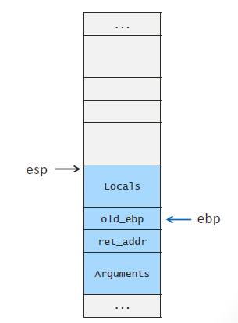

Slide 30
next

Slide 31
MOV Instructions

Slide 32
MOV Destination, Source
Copies data from Source to Destination
Example:
mov eax, 0x3A
mov al, 0x8
mov ebx, eax
mov cx, bx
mov ah, cl

Slide 33
Basic Arithmetic

Slide 34
Examples
ADD destination, source
Destination ← destination + source
add eax, ecx
add edi, 0x2A
add cx, si

Slide 35
Dword registers
mov esi, 0x1
mov eax, 0x2
mov ebx, 0x3
add eax, ebx
add eax, eax
mov esi, 0xFFFFFFFF
add ebx, esi
add esi, eax

Slide 36
Partial Registers
mov edi, 0xAB29FFFF
mov ecx, 0x00000703
mov eax, 0x000000FF
add al, ch
add di, cx
mov edi, 0xAB29FFFF
add edi, ecx

Slide 37
Basic Arithmetic
SUB Instruction

Slide 38
Examples
SUB destination, source
destination ← destination - source
sub eax, edx
sub edi, 0x2A
sub cl, dl

Slide 39
INC and DEC
Instructions

Slide 40
Examples of INC
INC register
register ← register + 1
inc eax
eax ← eax + 1

Slide 41
Examples of DEC
DEC register
register ← register - 1
dec si
si ←si - 1

Slide 42
MUL (Multiply)
Instructions

Slide 43
Examples of MUL
MUL register
ax ← al . register
dx:ax ← ax . register
edx:eax ← eax . register
edx:eax means that edx and eax are concatenated together
Note that the size of the result is twice the size of the argument

Slide 44
Intro to JUMPS

Slide 45
Two types of JUMPS
Un-conditional jumps
jmp 0x04012428
Conditional jumps
jz 0x04012428
jnz 0x04012428

Slide 46
Conditional JUMPS
Based on values inside flags register

Slide 47
JZ (Jump Zero)
jumps only if the ZF is set to 1 (i.e. the result of the last calculation is zero), eg:
mov eax, 0x1
dec eax
jz 0x04012428
add eax, 0x5
0x04012428 add eax, 0x2
Jump is taken
EAX = 2

Slide 48
JNZ (Jump Not Zero)
jumps only if the ZF is cleared to 0 (i.e. the result of the last calculation is non-zero), eg:
mov eax, 0x1
inc eax
jnz 0x04012428
add eax, 0x5
0x04012428 add eax, 0x2
Jump is taken
EAX = 4

Slide 49
Other jumps

Slide 50
JS and JNS
JS = Jump if SF (sign flag) is set
JNS = Jump if SF is cleared

Slide 51
JC and JNC
JC = Jump if CF (carry flag) is set
JNC = Jump if CF is cleared

Slide 52
JO and JNO
JO = Jump if OF (overflow flag) is set
JNO = Jump if OF is cleared

Slide 53
Reading Flags Register Indirectly
Cannot read Flags Register directly
So, we can use the conditional jumps as an indirect way to read the Flags Register

Slide 54
Intro to CMP instructions

Slide 55
CMP (compare instruction)
CMP is used to compare 2 numbers
CMP A, B
A – B, then changes flags accordingly but does not change A or B
JC is also known as JB (Jump if Below)

Slide 56
Comparing unsigned and signed numbers

Slide 57
CMP unsigned numbers
The following instructions are for unsigned comparisons:
JB = Jump if Below
JBE = Jump if Below or Equal
JA = Jump if Above
JAE = Jump if Above or Equal

Slide 58
CMP unsigned numbers (3)
An intuitive way to understand the Jump Instructions:
Assuming: CMP EAX, EBX
Jump Instruction | Intuitive Meaning
JB (Jump Below) | Jump if EAX is Below EBX (EAX < EBX)
JBE (Jump Below or Equal) | Jump if EAX is Below EBX, or, Equal (EAX <= EBX)
JA (Jump Above) | Jump if EAX is Above EBX (EAX > EBX)
JAE (Jump Above or Equal) | Jump if EAX is Above EBX, or, Equal (EAX >= EBX)
JB is the same as JC (Jump Carry)
JAE is the same as JNC (Jump if No Carry)

Slide 59
CMP signed numbers
The following instructions are for signed comparisons:
JL = Jump if Less
JLE = Jump if Less or Equal
JG = Jump if Greater
JGE = Jump if Greater or Equal

